Slide 1

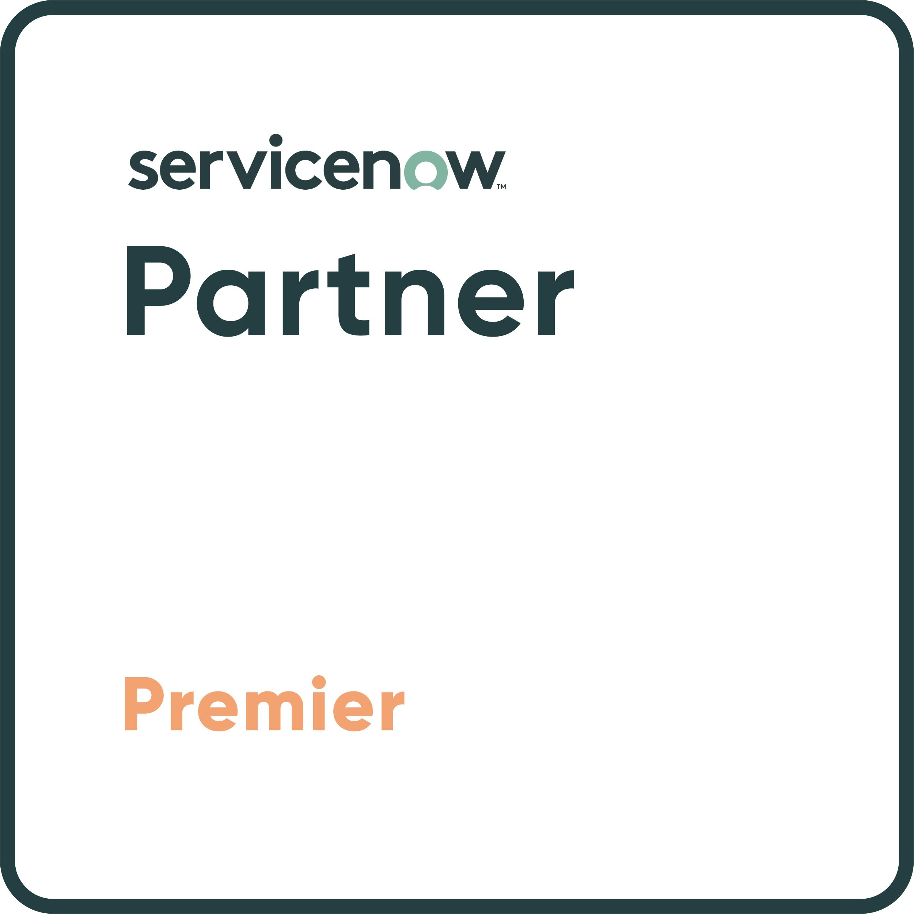
ACCELERATING BUSINESS TRANSFORMATION
Utah ServiceNow Release Upgrade Kit

Slide 2

Create value across your organization faster with simplified experiences, purposeful automation and organizational agility
Simplified experiences | Deliver simplified experiences that drive productivity and satisfaction Next Experience—Theme Builder Mobile Workspace
Purposeful automation | Drive purposeful automation, optimizing processes to reduce cost and maximize efficiency Process Optimization and Workforce Optimization expansion across the platform
Organizational agility | Create organizational agility to innovate faster with flexibility and scale Health and Safety

Slide 3
What’s new on Now Platform? on Now Platform?
Key Features | Description
Theme Builder | Easily create and manage branded themes to engage users
Unified theming in mobile apps | Deliver seamless experiences between web portals and mobile apps
Process Optimization | Expanded availability of in-platform process mining
Workforce Optimization | Expanded availability to develop high-performing teams across the enterprise
Document Intelligence enhancements | Accelerate and automate AI-enabled text extraction from documents to enhance user experience
ServiceNow Log Export Service | Seamlessly incorporate ServiceNow system and application logs into enterprise security analytics tools. Highly scalable and near real-time integration with log analytics solutions using a Kafka system or via a Kafka connector Easy setup with no additional coding needed Reduces cost and improves efficiency by exporting only the data needed Improves threat detection and user experience, and simplifies compliance monitoring and IT troubleshooting.

Slide 4
What’s new from Customer Service Management? Now Platform?
Key Features | Description
Omni Channel Callback | Help customers avoid queues by requesting an agent callback Allow customers to request a callback as soon as an agent is available via Engagement Messenger or a portal Empower customers to schedule a phone or Zoom callback with an agent Enable customers to add context to route the callback to the best available agent
Google Business Messages* | Allow customers to engage with a business directly from Google Empower customers to initiate conversations from Google entry points like search, maps, and websites Proactively send agent and system-initiated messages to customers via Google Business Messages. Create engaging conversational experiences with enhanced messaging capabilities like Rich Cards, Carousels, and Quick Replies.
Real-time voice transcription with Amazon Connect* | Convert live voice conversations into text with Amazon Connect integration Automatically capture and transcribe conversations in real-time via Amazon Connect integration Display conversation transcripts in the agent workspace alongside customer data and case details Provide agents and managers with conversation transcript logs to improve service and training gaps

Slide 5
What’s new from Customer Service Management?
Key Features | Description
Install base foundation | Provide a 360° view of a product's install base and services Establish association between child and parent install base items Capture foundational install base data including location, install date, status, and services in a single view Enable install base admins to authorize internal or 3rd party users to manage items on their behalf
Service Definitions | Define available services and case types for a given product Allow admins to associate relevant services and case types to products Present customers with a list of relevant services based on the products they own Automatically filter case type selection based on the customer's product model, context, and/or relevant service

Slide 6
What’s new from Field Service Management?
Key Features | Description
Task Bundling | Consolidate multiple work order tasks into a single trip to further streamline scheduling, and reduce travel time and service costs. Improve dispatcher efficiency by grouping similar work order tasks in to one bundle. Reduce travel costs and time, increasing service margins and reducing the carbon footprint. Increase daily workload and technician productivity while reducing the work order task backlog.
Equipment Scheduling | Easily schedule specialized tools and equipment, check in/out equipment, and ensure scheduled equipment is available and functioning properly. Support more granular scheduling needs to include specialized equipment. Minimize delays from waiting on needed equipment and speed time to task completion. Reduce lost, misplaced, or stolen equipment using check-out and check-in procedures.
Intra-day Schedule Automation | Dynamically adjust schedules to respond to real time field updates; improve contract compliance, technician utilization, and productivity. Reschedule work automatically and minimize guesswork for dispatchers. Reduce penalties by ensuring work gets rescheduled appropriately in accordance with contractual obligations. Deliver a better experience by ensuring schedule gaps are closed, and technicians and customers stay informed of changes.

Slide 7
What’s new from Field Service Management?
Key Features | Description
Process Optimization | Continually improve service processes and experiences. Increase visibility of end-to-end processes to uncover hidden delays and bottlenecks. Improve traceability to connect KPI trends to underlying processes. Reduce costs by identifying the root cause of process inefficiencies and implementing corrective actions.
Workforce Optimization | Continually improve the quality and efficiency of service teams through improved scheduling, learning, and coaching of individuals and teams. Increase organizational dispatch and scheduling efficiency. Improve the management of shifts and time-off requests. Identify and promote resource coaching and team improvement initiatives.

Slide 8
What’s new from IT Service Management & DevOps?
Key Features | Description
Service Operations Workspace Enhancements | Lower MTTR, simpler deconfliction, more efficient investigations Incorporate the full change lifecycle experience with dynamic pages for all states Simplify change scheduling–access all aspects of the process in a single, intuitive view Investigate incidents, in-context, with metrics and data from Microsoft Endpoint Manager
Workforce Optimization Enhancements | Improve employee engagement. Foster and promote skill growth within an existing organization. Enable agents to self-assign learning paths and courses based on their preferences Recommend optimal agent training via machine learning analyses on past work Keep momentum and measure success with learning progress visible in your workspace
Digital Portfolio Management and DevOps Integrations | Empower Solution Owners with key DevOps DORA & Flow metrics in a business app context to improve velocity and quality of value streams Better inform business-critical decision making by integrating DevOps flow metrics for deeper operational insight Streamline management with a simplified experience and redesigned interface Implement fast with popular KPI groups, easily mappable to your portfolio
Success Dashboard Enhancements | Maximize the value delivered of your ServiceNow investment by driving continuous delivery and improvements Go beyond Virtual Agent & ITSM - measure the success and maximize the value of your ServiceNow product portfolio including HRSD, LSD, and WSD via a single dashboard. Analyze performance with added context from benchmarks via peer comparisons Identify improvement areas via Automation Discovery to enhance value realization

Slide 9
What’s new from IT Operations Management?
Key Features | Description
Cloud Operations Workspace Enhancement | Increase cloud efficiency with a powerful user experience Explore Kubernetes in context with other cloud resources from the Cloud Operations Workspace Visualize cloud Discovery, resolve errors, and track progress Quickly integrate AWS, Azure & other cloud data with plug-and-play service graph connectors
Automated Machine Learning (ML) service mapping suggestions | Speed time to value by putting technology in its full business context Map services fast with higher fidelity using less manual effort Start mapping with less expertise and preparation; No entry points required Create application services prescribed by ML with just a few click
Instantly manage containers via cloud native operations (CNO) | Container based innovations accelerate cloud value Cloud native operations (CNO) scripts deploy containers with built-in visibility and health CNO containers automatically scale discovery resources to meet demands Improved troubleshooting of deployment steps in Utah

Slide 10
What’s new from Configuration Management Database (CMDB)?
Key Features | Description
CMDB 360 dashboard for multisource data* | Prescriptive views of CMDB records from multiple systems Quickly identify records missing from key sources and address coverage gaps Leverage overlapping data points to build trust and increase efficiency Publish out-of-box insights about cloud versus on-prem infrastructure
Identify and reconcile core business Data | Simplify data management across ServiceNow tables Leverage the Identity and Reconciliation Engine (IRE) to process non-CMDB tables Unify data management best practices and policies Automate quality improvement in location, user, and related core business data

Slide 11
What’s new from Software Asset Management?
Key Features | Description
SAM Success Value Builder | Execute on untapped Software Asset Management opportunities Drive continual progress toward success goals with insights into underutilized ServiceNow Software Asset Management (SAM) capabilities Roadmap a success plan with a holistic view into available SAM integrations, playbooks, apps, plugins, and software not under management Create ,assign ,and track new value builder tasks through completion using Software Asset Workspace
Containerized Software Licensing | Discover and manage license compliance for software deployed on containers Discover container infrastructure and licensable software installed on Docker and Kubernetes, on-premise or on cloud Determine license compliance position for Microsoft SQL Server and Microsoft Windows Server products deployed on containers Actively monitor container utilization and auto-create remediation options when non-compliant
Multi-currency support for Entitlement Import - enhancement | Import software entitlements with support for different currencies Specify currencies for each entitlement prior to importing entitlements into ServiceNow Software Asset Management
SAM Health Check - enhancement | Perform health checks scans for Oracle Database Server and Microsoft 365 configurations Accelerate time to value with proactive reporting on the configuration health of your Oracle DB Server and M365 configurations Get prescriptive guidance and take remediation actions to correct configuration issues

Slide 12
What’s new from Software Asset Management?
Key Features | Description
Software Contracts Renewal Calendar | Plan for upcoming software renewals with a calendar view of expiring entitlements and contracts Gain visibility from a single calendar view into all software contracts and entitlements up for renewal and set to expire Drill down into contract and entitlement details to better plan and manage renewals for SaaS and on-prem software Automate software and contract renewals across all stages of the purchasing process with Contract and renewal management
IBM IASP Partner support | Optimize IBM licensing with the Anglepoint IASP application Simplify IBM license management using the Anglepoint IASP application, Software Asset Management publisher pack for IBM, and ServiceNow Discovery Discover IBM software and server capacity and accurately report on usage without requiring authorized tools or additional integrations Manage full and sub-capacity licensing for on-premise IBM software with support for Processor Value Unit (PVU), Resource Value Unit (RVU MAPC), and Virtual Processor Core (VPC)
Advanced License Consumption Rules | Leverage advanced license consumption rules to allocate software entitlements Create allocations to entitle specific users or devices leveraging advanced license consumption rules to share or limit rights to entitlements
SaaS License Management - enhancement | Leverage D - V integrations to manage SaaS costs & usage with enhancements to M365 & Adobe Provide Last Activity date for Microsoft 365 subscriptions and determine unused licenses on M365 Admin Center Allocate full-suite subscriptions to those using more than 3 Adobe products, reclaim individual product subscriptions

Slide 13
What’s new from Cloud Insights?
Key Features | Description
Database Rightsizing | Optimize cloud database utilization and spend Gain rightsizing and cost optimization recommendations to reduce costs and improve cloud database utilization Automate the sizing of overprovisioned databases or shut down unused databases using approval workflows Support optimization efforts for select databases running on AWS, Azure, and Google Cloud Platform

Slide 14
What’s new from Hardware Asset Management?
Key Features | Description
Hardware Asset Procurement Workspace | Manage asset procurement activities from a single workspace Track & manage asset procurement activities from single view in Hardware Asset Workspace Drive outcomes with recommended activities, alerts, and actionable insight on open requests, purchase orders, pending transfer orders, and more Stay on top of critical tasks, deliver services quickly, and empower employees with the assets they need, when they need them
Asset Donation workflow | Automate technology donations to charities with workflow Streamline asset donations to charitable organizations in Hardware Asset Workspace with a complete workflow Request, approve, plan, and schedule donations and properly prepare assets by adding tasks to asset donation orders Maintain an accurate record of acknowledgement documentation for charitable donations
HAM Licensing Exclusion for MSP | Exclude specific assets from leveraging HAM functionality Gain more control over your asset management service by toggling ServiceNow Hardware Asset Management (HAM) on or off at the asset record level Limit what assets can leverage ServiceNow HAM functionality by disabling HAM features for assets tied to specific to geographies, departments, cost centers, etc. Ensure healthy operations with automatic notifications every time an excluded asset has been added to an Asset Flow and must be removed
Pallets for Inventory | Manage palletized assets within inventory stockrooms Manage inventory effectively by associating assets to a pallet for bulk updates and alignment with warehouse best practices Know the precise location of assets in a stockroom using the aisle and space details of the pallet Meet supply chain and logistics needs with increased accountability for assets not in use

Slide 15
What’s new from Security Operations?
Key Features | Description
New Vulnerability Response Workspace | Unified workspace for Vulnerability Managers Manage vulnerabilities and misconfigurations across assets from a single workspace with a modern user experience Create watch topics, remediation efforts and tasks for all vulnerabilities (hosts, application, and containers) and misconfigurations from a single view Schedule the recurring creation of remediation efforts and remediation t asks Multi-task across modules by keeping items open in tabs
Security Incident Response Workspace | Flexible and reimagined user experience. Designed with Tier 1 and 2 security analysts in mind and includes all new analyst dashboards and investigation canvas to manage incident s and workload Leverage play books and recommendations to easily move through an investigation Orchestrate actions directly with out-of-the-box integrations

Slide 16
What’s new from Strategic Portfolio Management?
Key Features | Description
Strategic Planning Workspace | Enable focused planning to align work with strategy and drive strategic outcomes Visualize planning and delivering work from different perspectives (lenses) such as organization, product, strategic investments, goals, value stream or a custom configuration Create and share portfolio plans to prioritize and visualize relevant work to align stakeholders Track progress towards strategic goals efficiently and accurately by automating the collection of actuals via Goal Framework for SPM
Benchmarks | Make data driven decisions to drive continuous improvements Compare company performance to peers of like size and location using industry averages and trends Analyze and optimize performance with actionable insights based on KPI values Boost performance by creating well-informed improvement initiatives

Slide 17
What’s new from Application Portfolio Management?
Key Features | Description
Enterprise Architecture Workspace | Empower Enterprise Architects with a modern, data-centric user experience to accelerate decision making Empower better decisions with new dashboards containing consolidated insights Proactively identify areas for improvement and redundancies within business application capabilities Continuously manage inventory health to reduce cost and risk Take action to address high priority requests directly from the home screen Smart filtering on dashboards to display relevant data
Digital Integration Management | Quickly document, model, and understand APIs and integrations to uncover insights and trace dependencies Standardized intake form to add integrations and relationships to business applications Leverage approval workflows to ensure alignment with business needs Document the landscape of integrations and APIs to visually understand the dependencies between business applications

Slide 18
What’s new from HR Service Delivery?
Key Features | Description
Workforce Optimization for HR | Help HR leaders build productivity with the ability to visualize their team’s skills, schedule, and workload. Drive productivity with visibility into your team's skills, training and schedules for better workload balancing Create learning opportunities with AI powered skills and learning recommendations Visualize and validate demand forecast based on historical workload
Manager Hub | Support Managers with enhanced data visualization and AI recommendations Visualize in-depth performance analytics and team trends on new Team Insights pages Easily suggest actions for your team with proactive prompts that drive increased engagement Leverage out-of-the-box suggestions to create content for your team
Employee Center | Support employees with enhanced navigation, improved search and intuitive content suggestions. Customize the Employee Center with improved navigation allowing the ability to change to order of the menu Increase the speed of content discovery with new topic page aligned content and topic filtering Increase content visibility through additional admin controls supporting the addition of content by category

Slide 19
What’s new from Workplace Service Delivery?
Key Features | Description
Health and Safety | Promote wellness and safety culture in the workplace. Enable employees to report safety incidents and near-misses with self-service information and reporting. Deliver a role-based experience for report management, including the ability to export OSHA incident logs and annual summaries. Empower safety teams to conduct investigations with an injury and illness log, perform a root cause analysis, and assign corrective/ preventative actions.
Workplace Reservation Management | Enable neighborhoods and location privacy preferences for employees. Empower employees to view and schedule reservations in neighborhoods. Provide employees with the ability to indicate their privacy preference when creating a reservation. Generate and share URLs that are linked to a specific space within the Location Directory with colleagues.
Workplace Maintenance Management | Create and manage workplace maintenance plans. Create corrective and preventive maintenance plans across workplace locations. Automate the creation of a case when a workplace maintenance request is received or created. Provide admins a maintenance plan overview to review key information, case status, and focus areas.
Workplace Lease Administration | Enable facilities managers to track various workplace contracts. Create and track workplace leases in a centralized workspace. Configure notification cadence for upcoming lease expirations. Track spaces, workplace assets, and services along with their associated costs as part of a contract.

Slide 20
What’s new from Workplace Service Delivery?
Key Features | Description
Workplace Space Management | Enhance and automate the space planner experience. Share space plans and secure necessary approvals from stakeholders for scenario deployment. Easily assign spaces and employees to neighborhoods and relate them to their department, cost center, or group. Automate space fulfillment requests by allowing the workplace system to identify and provide a best possible seating option based on requirements.

Slide 21
What’s new from Legal Service Delivery?
Key Features | Description
Third-party contract review | Streamline legal review and approval for third-party contracts. Automate intake, routing, and eSignature to designated legal teams Collaborate on suggested contract changes between third- party and in-house legal teams Track revisions along with configurable document storage options
Legal catalog builder | Quickly create and publish legal intake forms to employee portal Enable legal operations teams to deploy new legal workflows without code. Automate the assignment of new workflows to specific practice areas. Track progress of workflow with real-time reporting to help improve service delivery.

Slide 22
What’s new from Integrated Risk Management?
Key Features | Description
Operational Resilience – Workspace Enhancements | Defines service dependencies and resilience metrics for improved visibility, efficiencies, strengthened compliance and risk posture. 360-degree visualization to apply context and define relationships of enterprise-wide data and assets for understanding of upstream and downstream dependencies Modern, new design, global navigation, and persona-driven, configurable workspaces to increase productivity and simplify navigation Enhanced user experience for managing importance and impact tolerance, scenario analysis, self-attestation, and business services
Common Control Management | Save time and effort by reducing unnecessary control testing Create a common control that can be linked to multiple entities to reduce the number of controls that must be maintained Inherit control testing result of common control, for primary entity, to all linked entities for risk identification, audit, and compliance purposes – reducing time and cost of control testing
Issue Management | Increase efficiency with simplified issues management Create a single issue that can link to multiple risks, controls, entities, and other objects to eliminate duplicate issues Simplify audit with fewer issues that present a holistic view of the impacted controls, engagements, risk events, and other sources Tag an issue to multiple sources of failure (ex. multiple controls) to improve risk tracking and analysis

Slide 23
What’s new from Environmental, Social, and Governance (ESG)?
Key Features | Description
ESG integration with Workday | Automates the collection of human capital KPIs (such as employee demographics for workforce diversity disclosures). Ingest employee demographics data from Workday automatically into ESG Management Pull data at desired frequency to monitor progress towards goals Save time, reduce manual data transcription errors, and create an audit trail to maintain compliance with emerging regulations

Slide 24
What’s new from Enterprise Asset Management?
Key Features | Description
Enterprise Asset Maintenance | Create planned and preventative maintenance plans for enterprise assets Extend the life of enterprise assets by planning maintenance of physical equipment across locations Create maintenance schedules associated with models or assets based on user-defined rules triggered by time, usage, or condition Demonstrate asset maintenance with documentation for audits, inspections, or need
Enterprise Asset Work Management | Easily and quickly create work orders with multiple tasks based on pre-defined work templates Initiate and assign planned or ad-hoc enterprise asset work orders, enabling technicians to request parts required for their work & assign them asset pick up tasks when their requested Keep enterprise asset information including component and multi-tier assets accurate when performing work by using smart asset actions to deploy, swap, or remove assets and parts Improve asset reliability through analyzing work order history and trends to inform future allocations and purchasing decisions
Enterprise Asset reclamation | Simplify enterprise asset offboarding processes with prescriptive workflow Automate the request, reclamation, evaluation, and retiring of enterprise assets during employee transitions Ensure the timely receipt of assets by tracking asset reclamation through ship, drop off, and pick-up flows Leverage evaluation flow to determine which assets can be redeployed, repaired, retired, disposed, or returned to inventory
Asset resale workflow | Recycle and resell enterprise assets with a workflow Maximize return on enterprise asset investments leveraging asset resale flow to resell enterprise assets Keep an accurate record of assets being resold after usage and ensure assets are prepared properly for resale

Slide 25
What’s new from Enterprise Asset Management?
Key Features | Description
Asset disposal with resale workflow | Resell assets in a disposal order Use a task-based approach to resell part or full assets in a disposal order Keep accurate documentation of assets being resold as a result of a disposal order including resold value
Advanced Shipment Notification support | Create asset records ahead of receipt using a standard template allowing for more time for asset planning and increasing data accuracy Provide vendors with a standard template to provide uniform asset data prior to receiving assets Easily create asset records through an easy –to-use import tool
Procurement - sourcing | Source procurement requests from the Enterprise Asset Workspace Track and manage service catalog requests, requested items, and catalog tasks in the Enterprise Asset Workspace
Mobile Agent for enterprise assets | Accurately track the movement of enterprise assets Create and manage serialized and multi-component enterprise assets through simplified and streamlined workflows using the ServiceNow Mobile Agent application
Integration with Zebra MotionWorks | Accurately track the movement of enterprise assets Use RFID technology to capture asset movement as asset tags are scanned in their physical locations

Slide 26
What’s new from App Engine?
Key Features | Description
App Engine Studio – Restrict App Creation | Manage & govern users by applying group restrictions to anyone that is part of the user group. Restrict member users from creating new applications from scratch or from templates Edit only the applications you have been given access to as Member users Leverage guided setup to view information in the new App Engine Studio User Limited group
App Engine Studio – Request Management Application Usage | Address your employee’s most urgent needs by easily creating request-based apps from a prebuilt AES template. Deliver the highest level of service support quality to your organization Enable employees to do their best work by providing access to the services
Table Builder – Upload Spreadsheet and Extend Table | Save time & resources by uploading your spreadsheet to one of out-of-the-box tables. Leverage existing fields from a table template while creating new fields where needed Provide users ability to map source fields from their spreadsheet to target fields in their table Simplifies the initial upload of spreadsheet data to template tables
App Engine Studio – Template Feature Support | Empowers creation of custom app templates with richer features Create richer app template with additional platform features Standard catalog items, categories and user criteria PAR dashboards and indicators Process Automation Designer Translations UI Pages Credentials Data Policy Decision Tables

Slide 27
What’s new from Automation Engine?
Key Features | Description
Automation Center enhancements | Get deep business value analytics across more automation technologies Get real-time insights into automation ROI across vendors & track business new Value Dashboard Broaden automation coverage by expanding Automation CIs to Integration Hub flows Integrate fast with UiPath RPA using Integration Hub UiPath spoke
Stream Connect for Apache Kafka | Simplify and scale Kafka event streaming Develop data ingestions with Apache Kafka in familiar, native experience within Flow Designer Consume and process messages and transform and insert data into ServiceNow tables with the Kafka Message Flow Trigger Push messages using drag-and-drop data pills and produce data on a topic using low-code Flow Action Kafka Producer step and build
RPA Hub enhancements | Accelerate and manage RPA deployments Enable the ServiceNow developer community to access RPA Hub on (PDIs) Record tasks across multiple applications to quickly build an RPA automation flow Visualize and coordinate bot process scheduling with Robot Calendar
Integration Hub Usage Dashboard | Gain complete visibility into Integration Hub usage and license compliance Understand adoption as a proxy for business value View licensed and unlicensed transactions for compliance purposes View transactions by top spokes, custom spokes, actions for granular visibility into adoption trends
Document Intelligence enhancements | Configure and support more complex document data extraction Set up, configure & monitor Document Intelligence solutions with an all-new admin experience Extract checkbox data and complex tables with new AI models and redesigned user interface

Slide 28
What’s new from Financial Services Operations for Banking?
Key Features | Description
Intelligent Servicing for Fraud* | Facilitate simple and timely fraud resolution with connected technology and teams Provide full transparency by allowing customers and back-end systems to initiate cases, prioritize high- impact issues to help reduce financial losses, and remain compliant with embedded SLA tracking Reduce pain points such as email-based communication, difficult case tracking, and manual case updates by enabling interoperability between disparate systems and teams Streamlining processes with decision-making automation through business rule engine & connect fraud cases across all lines of business to obtain insights & identify patterns
Jack Henry Integration | Provide seamless client servicing with real-time visibility into accounts and transactions Reduce development effort and increase speed to market with a pre-built integration that can be triggered by any workflow Increase customer satisfaction by quickly providing the right information in real-time Improve employee efficiency and resolve customer issues from a single view by enabling quick access to customer profiles, account information, and transaction details to fulfill requests
Branch Manager Dashboard | Empower branch managers with visibility across business domains Provide branch managers with a holistic view of branch operations and the ability to easily raise requests on clients’ behalf Equip corporate HQ with a view of branch performance to identify opportunities for training and resource planning Discover opportunities for improvement with actionable insights around how service requests have been trending over time.

Slide 29
What’s new from Financial Services Operations for Banking?
Key Features | Description
Omnichannel Callback | Help customers avoid queues by requesting a service representative callback Allow customers to request a callback as soon as a representative is available via Engagement Messenger or a portal Empower customers to schedule a phone or Zoom callback with a representative Enable customers to add context to route the callback to the best available representative
Google Business Messages | Allow customers to engage with a bank directly from Google Empower customers to initiate conversations from Google entry points like search, maps, and websites Proactively send agent and system-initiated messages to customers via Google Business Messages Create engaging conversational experiences with enhanced messaging capabilities like Rich Cards, Carousels, and Quick Replies
Real-time voice transcription with Amazon Connect | Convert live voice conversations into text with Amazon Connect integration Automatically capture and transcribe conversations in real-time via Amazon Connect integration Display conversation transcripts in the employee workspace alongside customer data and case details Provide customer service personnel and managers with conversation transcript logs to improve service and training gaps

Slide 30
What’s new from Financial Services Operations for Insurance?
Key Features | Description
Personal Lines Claims | Streamline claims processing from FNOL through settlement , minimizing paper files and swivel-chairing between disconnected systems across multiple personas Automate claims processing through efficient data transfer between relevant personas to ensure claims files are current with pertinent information Eliminate manual work across Claims department for faster resolution & increased satisfaction using AI Empower claims personnel with curated workspaces in one centralized location t hat provides t he necessary data and information when and as needed
Ad-hoc tasks & enhanced landing pages | Ease day-to-day work for claims managers, adjusters, and processors through greater visibility across the claims portfolio View past and upcoming activities across t he claims portfolio with intuitive landing pages that make it easy to create, view , and prioritize tasks Help ensure claims and associated tasks are handled quickly with real- time key update alerts, such as a new claim assignment or rejection of an approval request Implement necessary adjustment s to the claims workflow with the quick creation of unplanned tasks, allowing for timely resolutions and strong employee and customer experiences
Guidewire Partnership | Allow ServiceNow to build capabilities to help providers streamline processes, eliminate swivel-chairing between systems, and gain real-time visibility to key information Create new experiences around claims and policy servicing with cross-platform visibility, communication, and audit trail Drive operational efficiencies by streamlining overall claims intake and processing through omnichannel experience, advanced work assignment , and more Increase process agility and speed to value with seamless customizations to processes, such as claims

Slide 31
What’s new from Financial Services Operations for Insurance?
Key Features | Description
Omnichannel Callback | Help customers avoid queues by requesting a serv ice representative callback Allow customers to request a callback as soon as a representative is available via Engagement Messenger or a portal Empower customers t o schedule a phone or Zoom callback with a representative Enable customers to add context to route the callback to the best available representative
Google Business Messages | Allow customers to engage with a carrier directly from Google Empower customers to initiate conversations from Google entry points like search, maps, and websites Proactively send agent and system-initiated messages to customers via Google Business Messages* Create engaging conversational experiences with enhanced messaging capabilities like Rich Cards, Carousels, and Quick Replies
Real-time voice transcription with Amazon Connect | Convert live voice conversations into text with Amazon Connect integration Automatically capture and transcribe conversations in real-time via Amazon Connect integration Display conversation transcript s in t he employee workspace alongside customer data and case details Provide customer serv ice personnel and managers with conversation transcript logs to improve service and training gaps

Slide 32
What’s new from Manufacturing?
Key Features | Description
Planned Downtime | Planned Downtime enables OT security professionals to plan their remediation activities around planned equipment downtime. Agile Response. Remediation of OT vulnerabilities takes less time. Accelerated Digitization. Process bottlenecks are eliminated. Improved Visibility. Single source of truth – downtime not on untrustworthy whiteboards, spreadsheets, or buried in ERP. Enhanced Awareness. Maximum transparency for organizations on their production process.
Operational Technology Incident Management | Operational incident management enables factory workers to create tickets whenever operational technology needs to be serviced. Accelerate Response Time. Better collaboration to resolve OT incidents. Respond strategically. New incident categories tailored for industries. The ability to view incidents grouped into safety, productivity or quality. Leverage institutional knowledge. Ability to learn and find solutions from incidents reported at other sites. Have read-only visibility into incidents reported at other sites. Drive accountability. Specialists can now view OT incidents / tickets that are assigned to them or belong to the site.

Slide 33
What’s new from Telecommunications Services Management?
Key Features | Description
3600 customer view* | Empower support teams with a 3600 view of customer accounts Quickly understand the business context, including key contacts, contracts and products sold Assess account health from CSAT score, escalations, and SLA achievement View and analyze operational trends Open and action tasks records Open related major incidents and cases and knowledge articles
Enhanced product catalog experience* | Improve product catalog experience with a single configurable workspace and a unified hierarchical visualization Manage, visualize, and track product offerings and their components in a single configurable workspace Visualize hierarchical product topology and dependencies and drill down to details Quickly update product definitions (bundles, characteristics, pricing, technical capabilities, etc.) to respond to evolving market dynamics
Enhanced horizontal relationship* | Manage product, service and resource dependencies via APIs, UI and in-flight change process Manage inclusive and exclusive peer-to-peer dependencies between products, services, or resources or resources via APIs Identify related items that are impacted by change or disconnect orders Enable agents to review, update or remove related items for change or disconnect orders Enable agents to create new orders with related items Support in-flight revisions of related item

Slide 34
What’s new from Order Management for Telecom?
Key Features | Description
Order prioritization and routing* | Prioritize and route orders based on customer, product, or service urgency Revise order priority to respond to changes such as errors or scheduling updates Allocate and assign tasks and activities based on the order priority Manage order priority via APIs
Enhanced service order management* | Aligned with TM Forum Service Ordering Management TMF641 OpenAPI Support in-flight changes of service order characteristics and quantities Support in-flight cancelation of order line items and service orders
Technical service qualification* | Confirm service availability before placing an order and meet customer expectation Confirm service availability by sending technical service qualification requests Process and coordinate technical service request and responses with external inventory systems via APIs Aligned with the Service Qualification Management TMF645 OpenAPI
Enhanced order processing performance* | Transform consumer and agent experience with improved performance Enhanced performance of asynchronous and synchronous order processing Reduce order bottlenecks when processing large volumes of enterprise and customer orders Process large volumes of orders using the product and service order APIs

Slide 35
What’s new from Telecommunications Network Inventory?
Key Features | Description
Enhanced technology and domain support | Model and manage all types of network technologies and domains Gain visibility into network inventory operations and metrics with personalized configurable workspaces Visualize complex network topologies and drill down to see equipment details Model equipment and easily design complex templates to deploy at scale Capture and maintain the entire lifecycle of all network inventory and utilize accurate audit trail data for asset management Automate network service creation with design and assign change workflows

Slide 36
What’s new from Technology Provider Service Management (TPSM)?
Key Features | Description
Operations account 360 | Empower technical support in the Service Operations Workspace with a 360 view of the customer accounts to make the right decisions fast. Quickly understand the business context, including key contacts, contracts, and products sold Assess account health from CSAT score, escalations, and SLA achievements View and analyze operational trends Open and action task records Open related major incidents and cases and knowledge articles
Enhanced product catalog experience | Manage, visualize, and track product offerings and their components in a single configurable workspace. Manage, visualize, and track product offerings and their components in a single configurable workspace Visualize a product’s topology and hierarchical relationships and drill-down to details Quickly update product definitions (bundles, characteristics, pricing, technical capabilities, etc.) to respond to evolving market dynamics

Slide 37
What’s new from Order Management for Technology Providers?
Key Features | Description
Order prioritization and routing | Prioritize and route orders to meet SLAs and support business goals. Prioritize and route orders based on customer, product or service type, financial value, customer request, and other rules Revise order priority to respond to changes, such as errors or scheduling updates Allocate and assign tasks and activities based on the order priority Manage order priority via APIs
Enhanced service order management | Monetize third-party orders with enhanced service order management support. Receive, change, and cancel service orders from third-party systems with a rich, standards-based API for service order management Support in-flight changes of service order characteristics and quantities and cancelation of order line items and service orders
Technical service qualification | Improve the customer experience by confirming service availability before placing orders. Accept service qualification requests from sales and ordering applications Coordinate service availability across various applications, partners, and inventory systems Leverage industry-standard APIs for service qualification
Enhanced order processing performance | Transform customer experiences and improve operational efficiency with improved order processing performance. Accelerate order processing with enhanced asynchronous and synchronous processing Reduce order bottlenecks when processing large volumes of enterprise & customer orders Efficiently process large volumes of orders using the product and service order APIs

Slide 38
What’s new from Impact?
Key Features | Description
Impact Accelerators for the C-suite—New | These accelerators provide visibility and how-to guidance for building the CxO dashboards Introduction to CxO Dashboards: Reveals the art of the possible with C-suite dashboards Jumpstart your CIO Dashboard: Guidance and tips for implementing the CIO Dashboard application
Impact Accelerators for platform owners— New | Personalized recommendations to help improve product adoption and maturity ITSM Maturity Assessment: Assesses adoption and maturity of IT Service Management and provides recommendations for improvement Jumpstart your Success Dashboard: Guidance and tips for implementing the Success Dashboard application for IT Service Management and HR Service Delivery

Slide 39
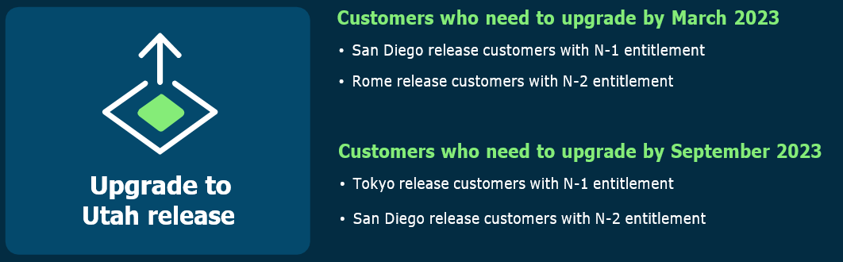
Who needs to upgrade to the Utah release?

Slide 40




+44 800 975 0157
intelibliss.com
info@intelibliss.com
THANK YOU
linkedin.com/company/intelibliss/
twitter.com/intelibliss
facebook.com/intelibliss/

